Slide 1

Music Controlled LEDs
ArIES Project

Slide 2
Members
Ayan Shree
Dev Srivastava
Akriti Jain
Ravi Prakash
Somil Dhiman

Slide 3
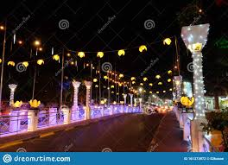
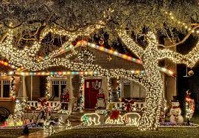
Introduction
Were you intrigued by the flickering lights in a concert or a disco?
What if I tell you that you can convert your room into one too…
We the team of, Ayan Shree, Dev Srivastava, Ravi Prakash, Akriti Jain and Somil Dhiman, present to you the project Music Controlled LEDs.

Slide 4
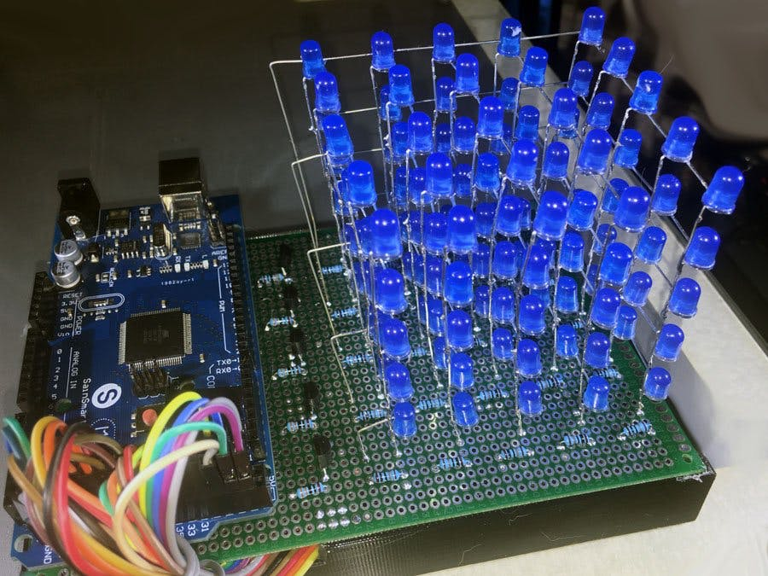
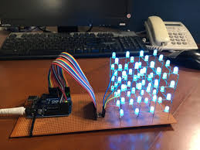
Objective
We plan on making a 3-D LED cube that lights up with different patterns in response to the music playing in background.
This will be accomplished by using an sound sensor and a LED circuit that responds to various intensity values.

Slide 5
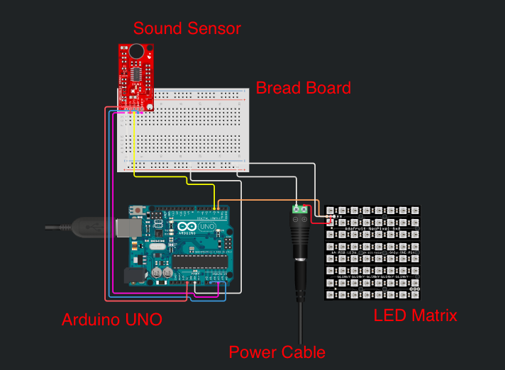

Components Required
Arduino Mega
LEDs
Intensity Sensor (KY-037)
Connecting wires
Resistors

Slide 6


Approach
Our approach towards the making on this project comprised of three major steps:
Collection and Analysis of Data sets.
Designing and simulating the circuit.
Writing the code and tuning the circuit to various patterns.

Slide 7
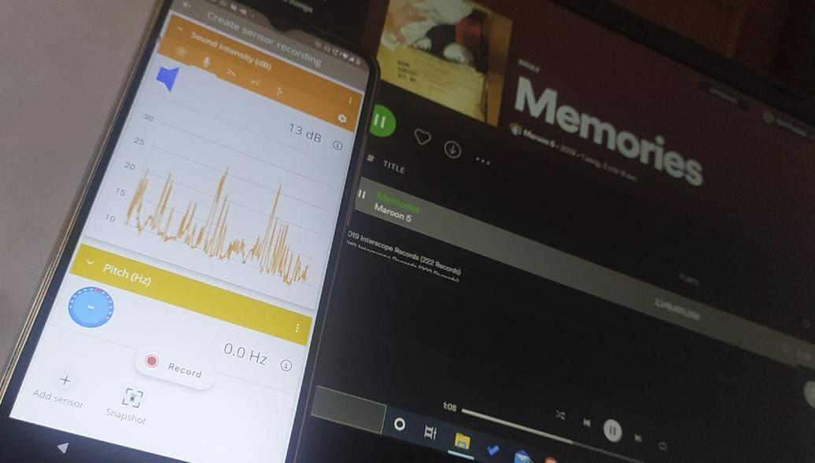
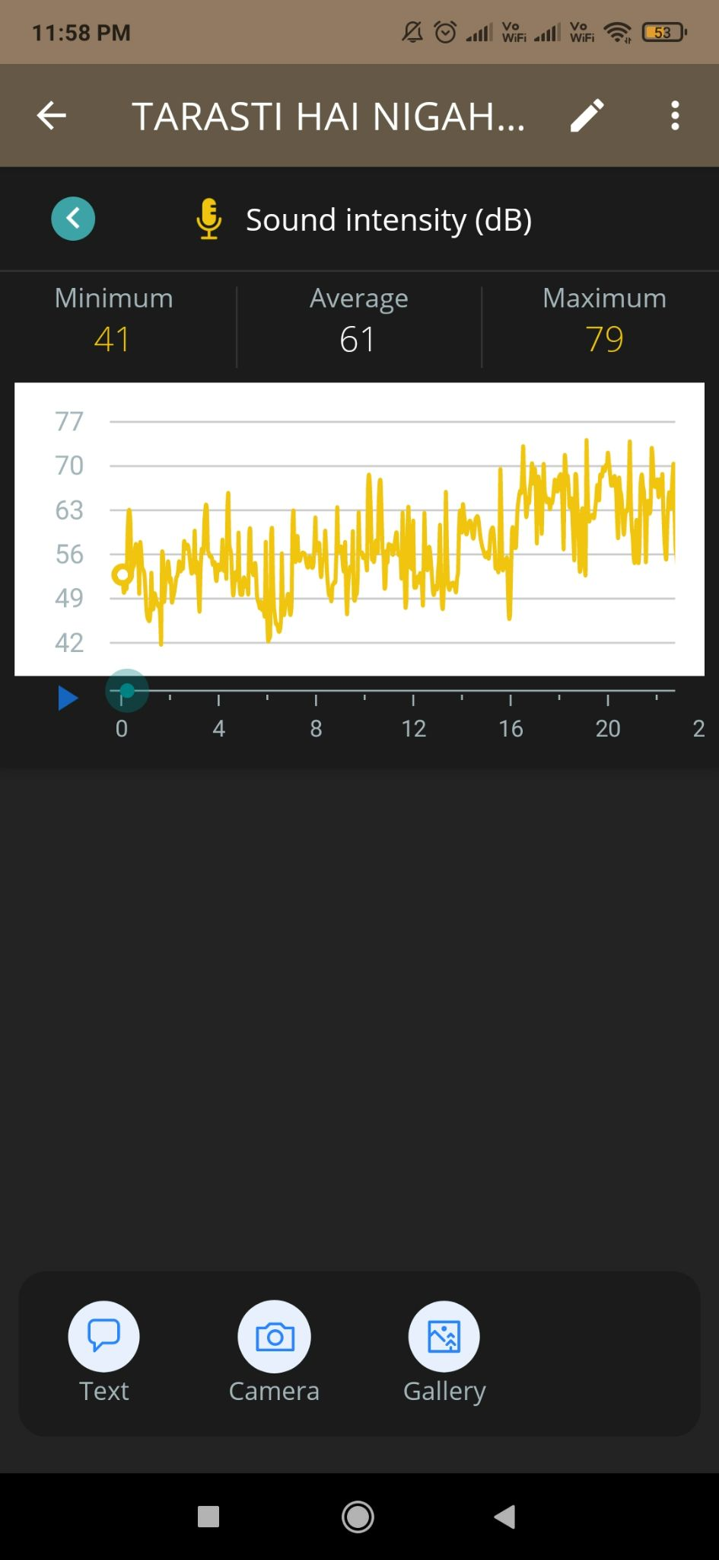
Collection and Analysis of Datasets
In order to determine the intensity parameters required to govern our circuit:
We sampled and recorded 25 songs from various genres and collected the intensity values as close as a hundredth of a second.
To achieve this we used the Arduino Science Journal App.

Slide 8
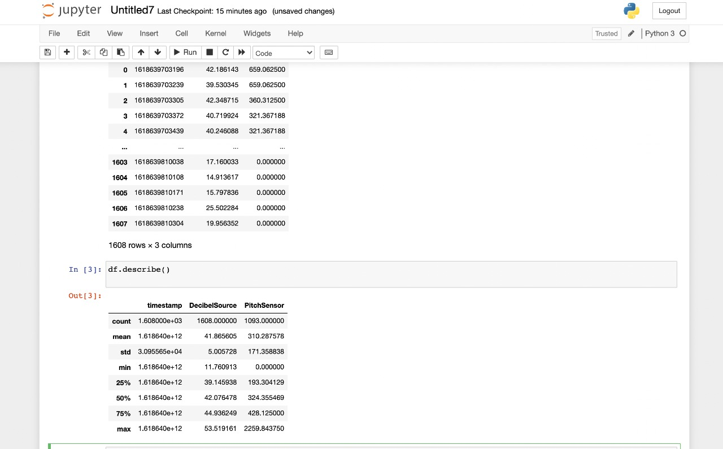
Continued...
Next we analysed the datasets using Microsoft Excel and Jupyter notebook.
After analysing around 65,000 data points we arrived at 6 ranges which will facilitate the transition of patterns in the circuit.

Slide 9

Design and Circuit Simulation
To design and simulate the circuit we used Tinkercad.
We first made a CAD model on Tinkercad 3-D design to give shape to the idea we had in our minds.

Slide 10
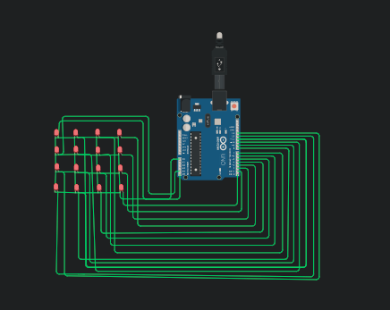
Continued...
Next we started designing and simulating the circuit on Tinkercad circuits.
At first we made a 4x4 layer of LEDs and connected all their cathodes together so that they have a common cathode and the LEDs can be controlled individually.
Next we tested the 4x4 layer with an Arduino Mega board.

Slide 11
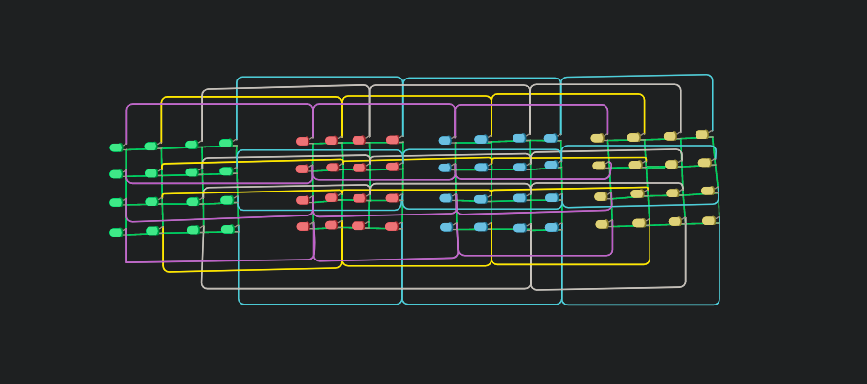
Continued...
Following this we extended our circuit to four successive layers, in order to make a cube.
We connected individual stacks of LEDs from anode to anode.
This gave us control over all the LEDs in the cube
Later we connected the individual anodes to the pins of the the Arduino Board

Slide 12

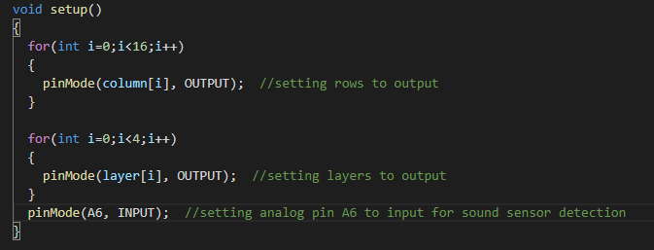
Writing the CODE
We have declared two arrays namely “layer” and “column”. It's being used to indicate which Arduino pin the LED is connected to.
The setup() function is triggered only once in the entire code run and here we are using it to initialize pin modes.
The pinMode() function configures the specified pin to behave either as input or output.

Slide 13
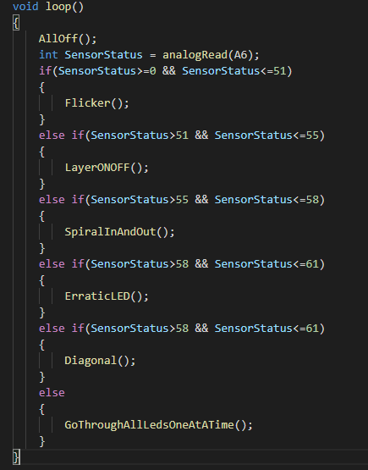
Writing the CODE
Next, the loop() function is used to actively control the arduino board and as the name suggests, this function runs consecutively.
Firstly, the AllOff() function is called that turns all the LEDs off.
The function analogRead() reads the value from the specified analog pin. This means that it will map input voltages between 0 and the operating voltage(5V) into integer values between 0 and 1023.The analog output voltage changes with the intensity of sound received by the microphone of the sound sensor. We will connect this output to Arduino analog pins and process the output voltage.
This value is then stored in the variable Sens0rStatus.
Furthermore, we have used multiple if-else statements to trigger various patterns in accordance with the intensity ranges that we had gathered manually by recording songs.

Slide 14
Challenges Faced
First of all, executing, a completely hardware related project in online mode was itself the biggest challenge in execution of this project.
No Sound sensor was available online in the simulators, thus we had to pre-define the input variables.
Initially we had a plan to include both pitch and intensity sensors in our project. But there was no physical pitch sensor available in the repository. Thus, we had to drop the plan.
Due to lack of existing datasets we had to manually analyse the collected data and find out the relevant ranges.

Slide 15


Future Aspects
In this project, we were unable to add the sound sensor KY-037, so we aspire to add the same in our project, if available to us in hardware.
We would like to include a pitch sensor too in the project.
We would also like to include wifi esp microcontroller to get input signals from distant place.

Slide 16

Bibliography
https://www.arduino.cc/
https://www.tinkercad.com/
https://www.circuito.io/

Slide 17
Thank You

